Slide 1
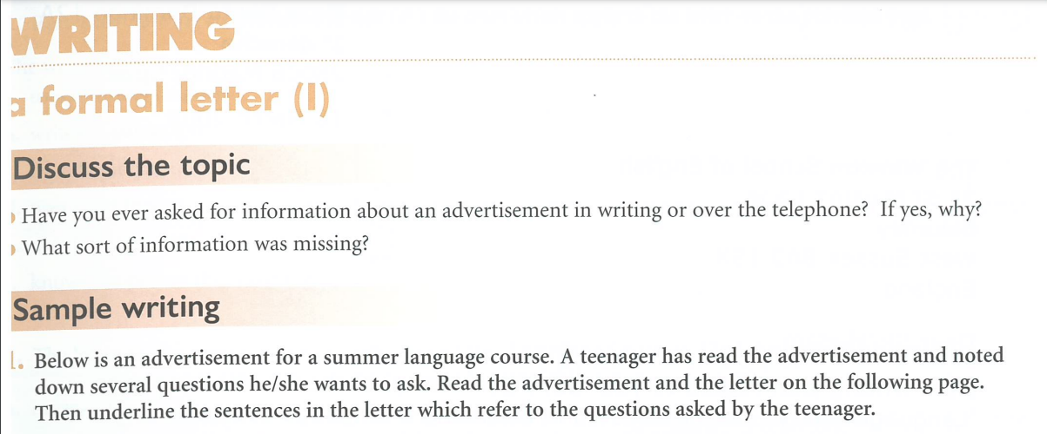

Slide 2
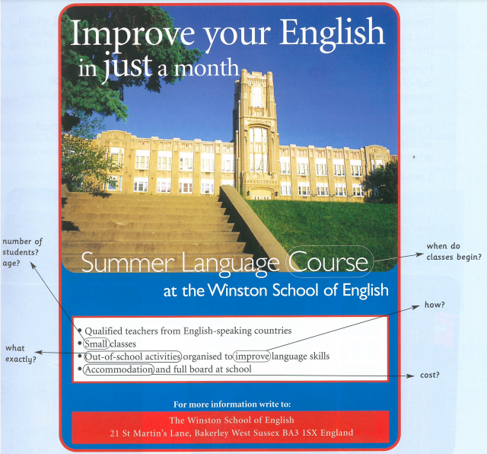

Slide 3
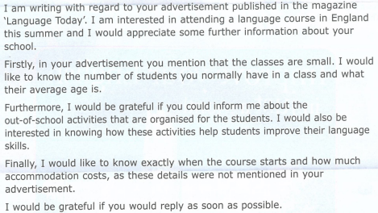
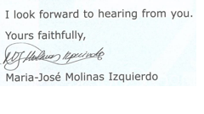
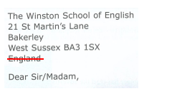
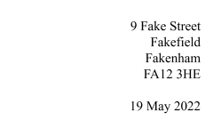
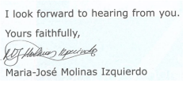
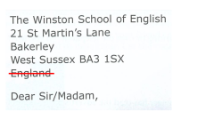
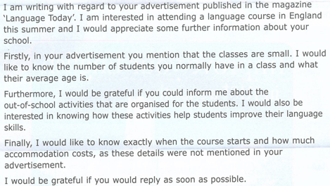
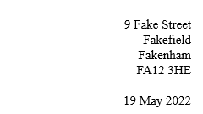

Slide 4
9 Fake Street
Fakefield
Fakenham
FA12 3HE
19 May 2022

Slide 5
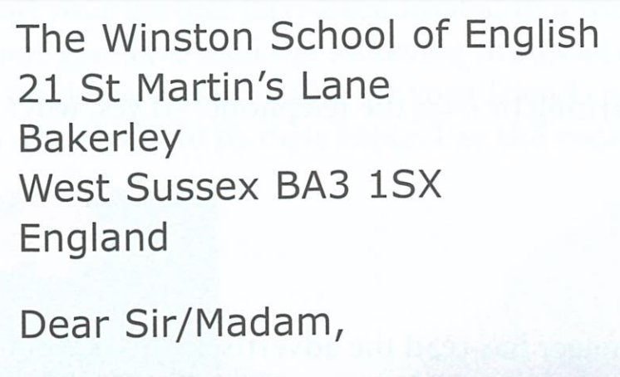

Slide 6
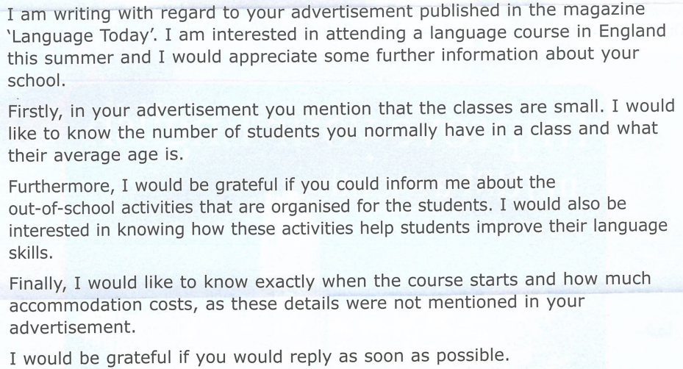

Slide 7
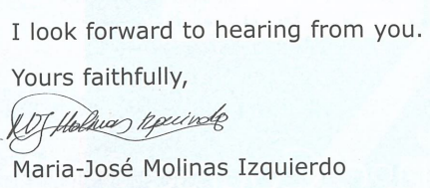

Slide 8
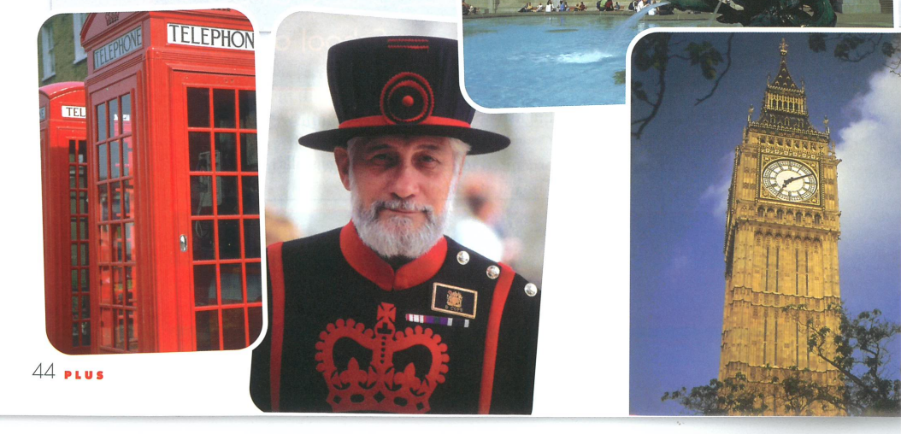
Red
telephone
box
Beefeater
Elizabeth/
Westminster
Tower

Slide 9
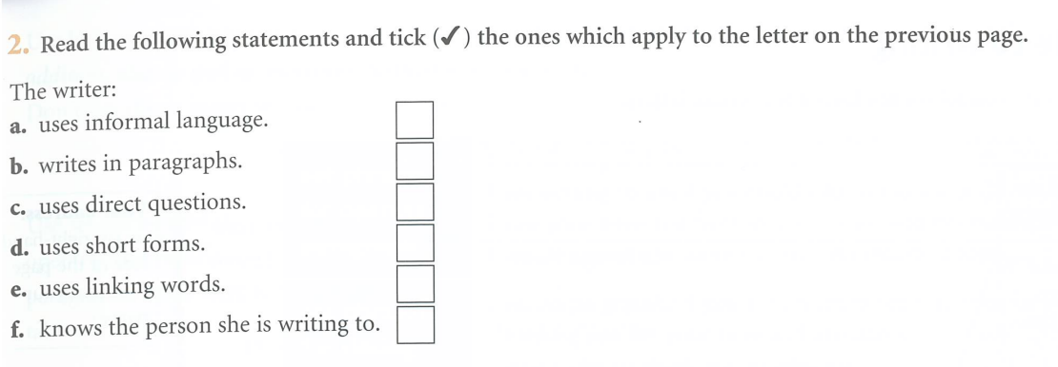
✔
✔

Slide 10
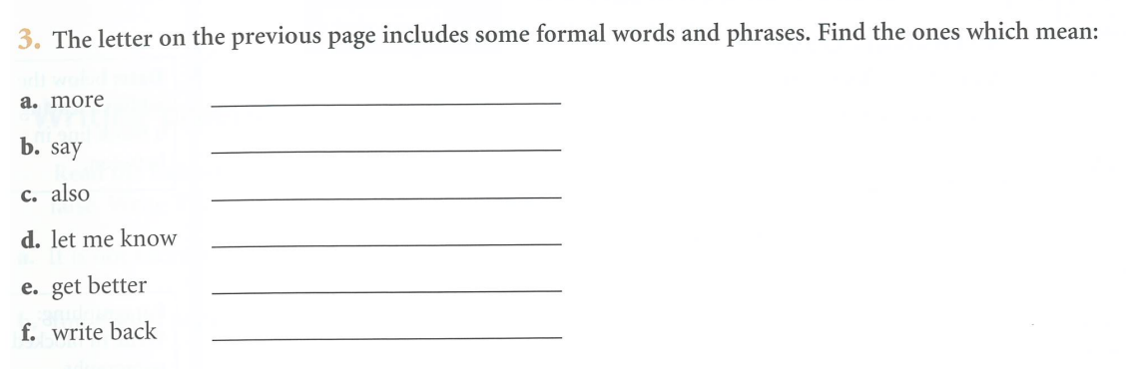
further
mention
furthermore
inform
improve
reply

Slide 11


Slide 12
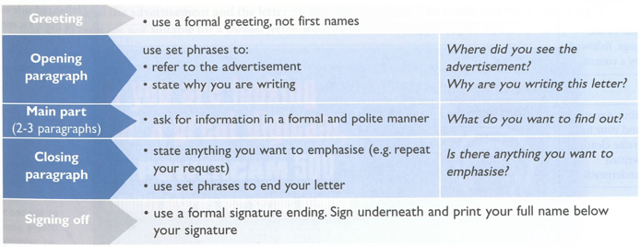
This is a guide to planning rather than a plan.
Your actual plan needs to actually answer these questions.

Slide 13
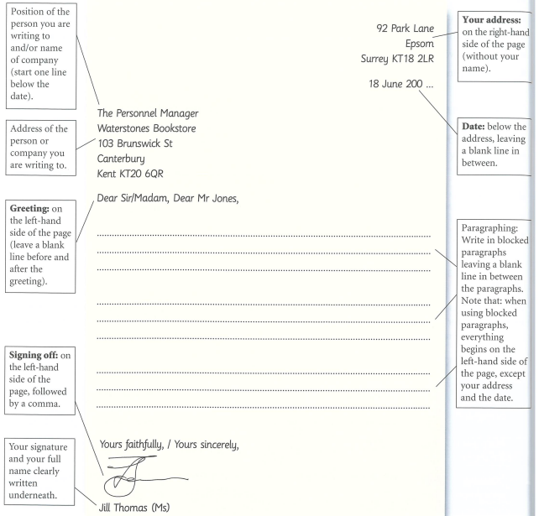
Actually, the Postcode should go under the city.

Slide 14
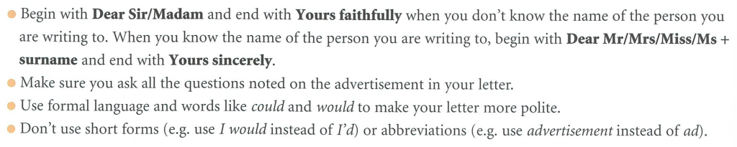

Slide 15
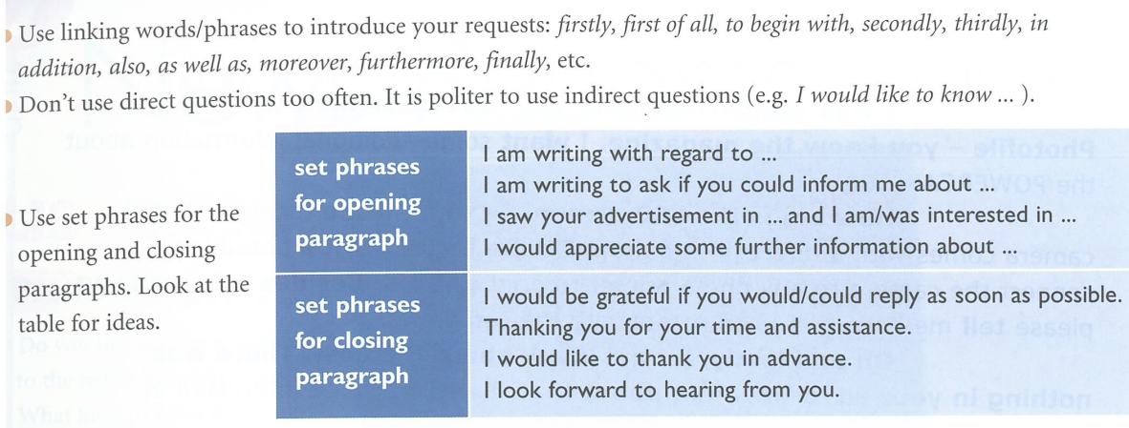

Slide 16
Reason for writing:
I am writing to receive further information about
I am writing to enquire about
I am writing to receive more detailed information about
I am writing to receive further details about
Requesting first piece of information:
The first thing I would like to know is
First of all, I would like to know
I wonder if you would mind telling me first of all ….?

Slide 17
Requesting further information:
Could you also tell me….?
Could you also inform me ….?
Would you also mind informing me ….?
Would you also mind telling me ….?
Do you know ….?
I would also like to know if
I would also like to know whether
I hope you might also let me know about …
Thanking for information:
I would like to thank you in advance for this information
Thanking you in advance for this information
Thanking you in advance

Slide 18
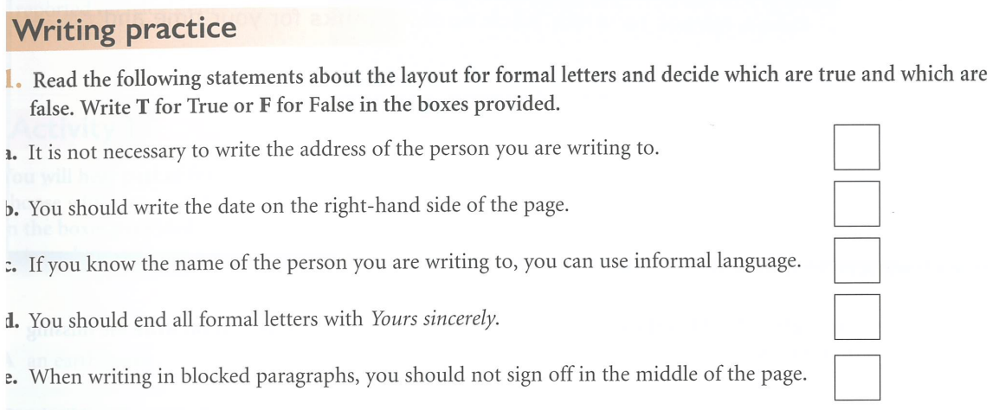
F
T
F
F
T

Slide 19
2. a. A teenager has seen the advertisement below in the magazine Photofile and has noted down some questions. Read the advertisement and the letter on the following page. The words and sentences in the letter that are in bold are not suitable for a formal letter. Rewrite them in an appropriate style.

Slide 20
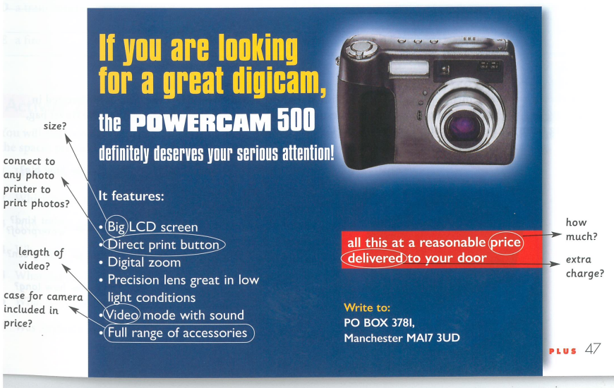

Slide 21
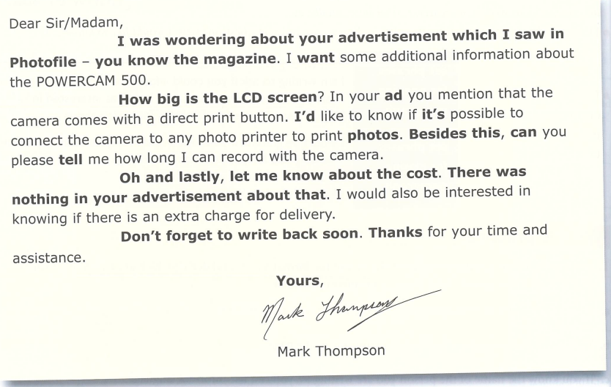

Slide 22
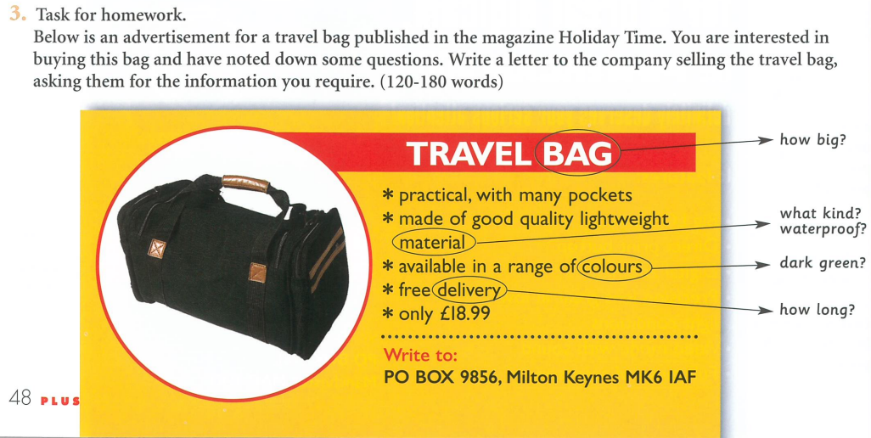

Slide 23
Please let me know what couese you want to do next and why. Send me a Teams chat.

